Slide 1
Deep into HandlerMapping
Group4
吳崇維 陳熙 林柏劭 王俊翔 蔡昀達
王郁婷 林慶珠 王廷峻 黃柏諭

Slide 2
HandlerMapping
What does it do?
An interface that defines a mapping between requests and handler objects.
Say that a URL request is coming, captured by DispatcherServlet.
Developer has defined several Controller for different situations.
Controller 1
Request : /example/login
where to go?
Controller 2

Slide 3
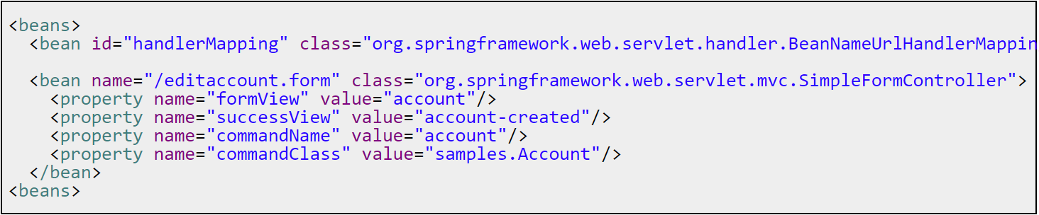
HandlerMapping : Example
Default HandlerMapping for Spring Web MVC ~> BeanNameUrlHandlerMapping
We now map the request “editaccout.form” to the Controller “SimpleFormController”
With some controller attributes
Directly use beanName to map to the controller

Slide 4
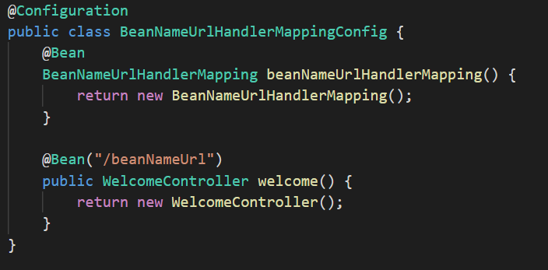
HandlerMapping : Another Example
Default HandlerMapping for Spring Web MVC ~> BeanNameUrlHandlerMapping
We can see why it is called BeanNameUrl : No extra config in these methods.
Simply map “/beanNameUrl” to “WelcomeController”

Slide 5
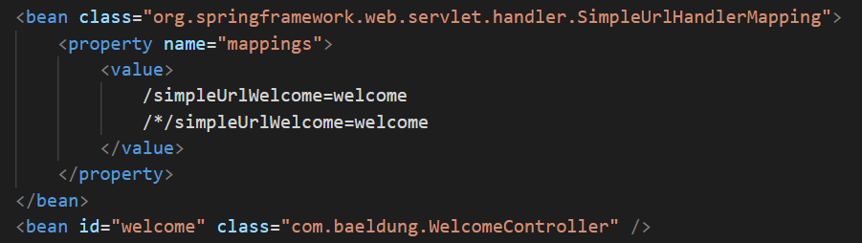
HandlerMapping : Flexible Approach
Another implementation of HandlerMapping : SimpleUrlHandlerMapping
We map both “/simpleUrlWelcome” and “/*/simpleUrlWelcome” to “WelcomeController”

Slide 6
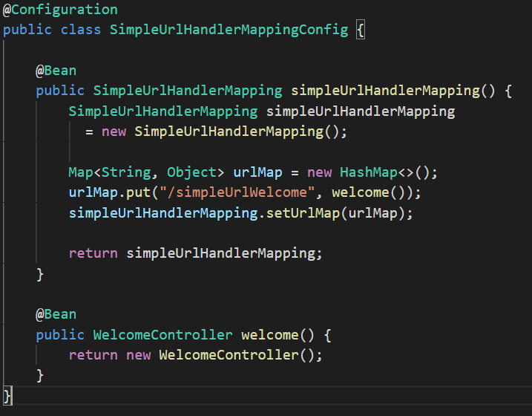
HandlerMapping : Flexible Approach
Another implementation of HandlerMapping : SimpleUrlHandlerMapping
We can see the differences between this approach and “BeanNameUrlHandler”.

Slide 7
HandlerInterceptor
Sometimes, we want to apply specific functionality to certain requests, for example, checking for a principal.
Let’s have a example for a better insight.

Slide 8
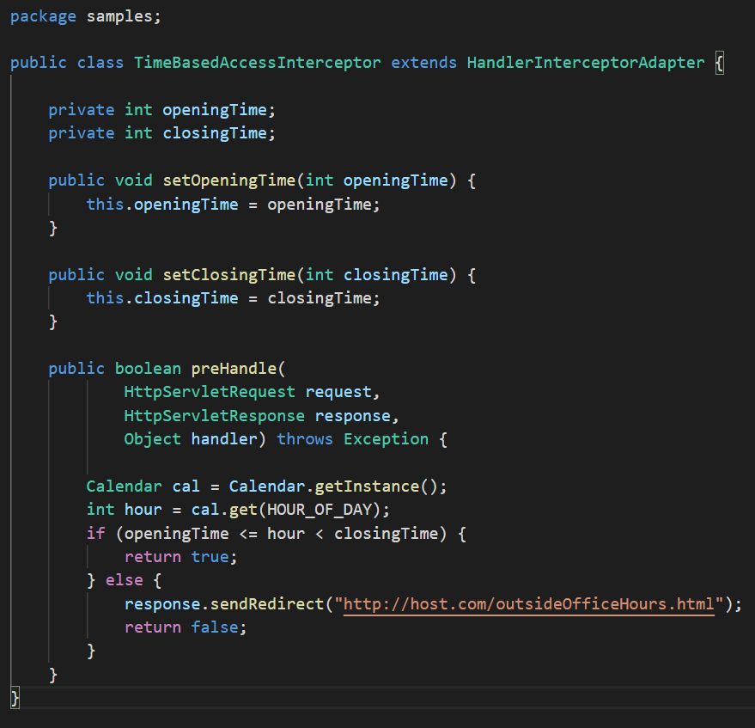
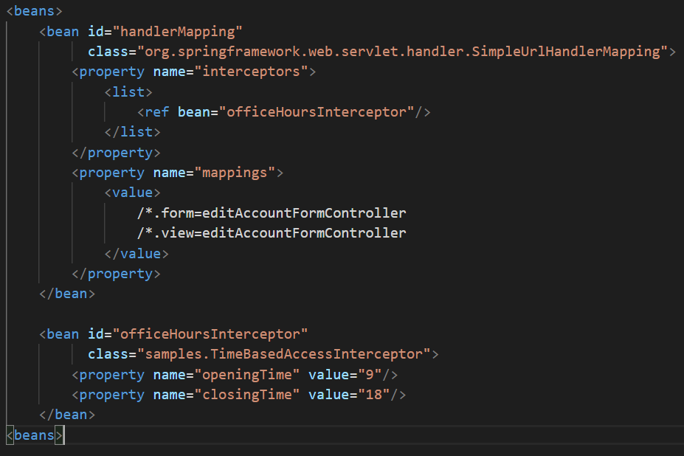
HandlerInterceptor
With an interceptor placed in a SimpleUrlHandlerMapping, all the requests will have to pass a preHandle() method before the true invoke.

Slide 9
Put it all together!
There will be a “HandlerExecutionChain”, which are responsible for how these handler & interceptors should be executed, by order.
Attribute in HandlerExecutionChain
Handler : The current handler we’re using
HandlerInceptor”s” : 0 to many interceptor to be invoked
Method in HandlerExecutionChain
applyPreHandle
applyPostHandle
triggerAfterCompletion

Slide 10
Put it all together!
Then we’re done! Leave rest of the things to “HandlerAdapter”

